Slide 1
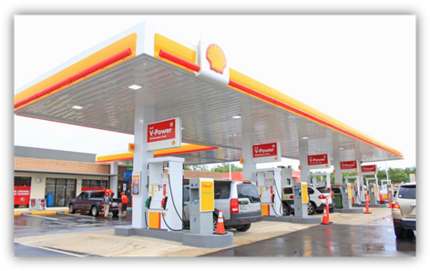

SMART FUEL DISPENSING SYSTEM USING RFID TECHNOLOGY AND GSM
Research Paper Presentation For
ICREACT-2022 Conference
Paper ID: R22012
by
G. Sairam Sumanth (RA1811004010232)
Mohan Reddim (RA1811004010497) K. Raja (RA1811004010535)
SRM Institute of Science and Technology, Kattankulathur
Department of Electronics and Communication Engineering
Under the Supervisor of
Ms. S. Suhasini
Assistant Professor (O.G), Department of ECE

Slide 2
CONTENT
Abstract
Objective
Introduction
Literature Survey
Block Diagram
Performance Analysis
Conclusion
Future Work
References
5/03/2022
2

Slide 3
ABSTRACT
The main aim of the project is to design a system which is capable of automatically deducting the amount of petrol dispensed from user card based on RFID technology.
Here we are going to present modern era petrol dispensing system which is meant to be operated with prepaid card using RFID technology.
The project mainly aims in designing a prepaid card for petrol bunk system and also petrol dispensing system using RFID technology. In current days the petrol stations are operated manually. These petrol pumps are time consuming and require more man power.
5/03/2022
3

Slide 4
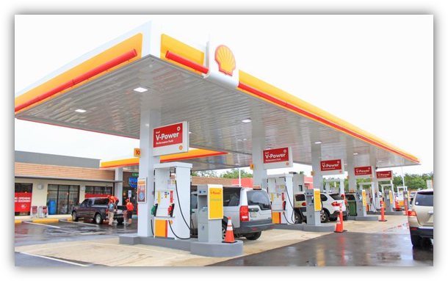
OBJECTIVE
The objective of this project is to provide easy access and save time in the fuel bunk.
Through this project we can achieve the dream of digital petrol pump stations.
Fig1 – RFID Fuel Station
5/03/2022
4

Slide 5
INTRODUCTION
The increase in the number of vehicles in India in recent years led to the congestions and traffic jams in almost all cities of India . The dispensing of the fuel to this huge number of vehicles at the fuel stations has caused many complications in India .
The vehicle driver has to pay for fuel with cash money and may have to pay more than the amount of dispensed fuel due to the lack of small money change available with station operator.
RFID Based Automated Petrol Pump , is to reduce human work and develop an auto guided mechanism and to implement the task .
Sequentially by using RFID technology .These systems are highly reliable and less time-consuming devices.
5/03/2022
5

Slide 6
LITERATURE SURVEY
S.NO | Title of the paper | Features | Remarks
1. | Kulkarni Amruta M. &Taware Sachin S(2019). Multipurpose Self Fuel Dispensing Automated Framework Utilizing RFID Prepaid Cards. . | They have designed on based on rfid technology of automative fuel out. With using rfid tags . | In our application, RFID framework apportions the exact measure of fuel which diminishes the abuse of the fuel. What's more, it additionally lessens the labor.
2. | Christo Ananth, G.Poncelina, M.Poolammal, S.Priyanka, M.Rakshana, Prakash.K (2018). A System Design for the Regulated Distribution of Automotive Fuel Using RFID. UKSim-AMSS International Conference on Modelling and Simulation (UKSim). | The majority of the system construction and implementation is in a petrol dispensing unit, where-in there is an application processor connected to a cloud database containing pertinent details regarding fuel consumption | Information is scanned by readers on the dispensing units and used to retrieve fuel consumption details of the user from the centralized database via the local servers
6
5/03/2022

Slide 7
S.NO | Title of the paper | Features | Remarks
3. | Pranto, M. B., Rahman, M. M., & Zunayeed-Bin-Zahir. (2020). Vehicle Fuel Monitoring and Management using RFID authentication and Telematics system. | In this project, they have proposed that the RFID application of the fuel management system by scanning RFID tags of the person allows it. | h RFID technology is being used in many sectors of security field, our system includes mobile application and automated fuel disposal pump with RFID technology which makes the system more efficient, secure and user friendly
4. | Al-Naima, Fawzi M and Hasan, Mohannad M (2015) Design and implementation of RFID-based fuel dispensing system International Journal of Computing and Network Technology | In this proposed petrol pump automation system, we are using RFID card to access petrol at different petrol stations of different petrol companies across the country and here. | By using this project one can design a secured system. For filling petrol to vehicles at the petrol bunks using Smart Card based Accessing System.
5/03/2022
7

Slide 8
EXISTING SYSTEM
In beginning days, the petrol pumps were disseminating petrol utilizing labor to particular client vehicles and were thoroughly relies upon man’s steadfastness who was carrying out this responsibility.
These petrol pumps are time consuming and require more man power. To place petrol stations in distant area is very costly to provide excellent facility to the consumers.
All these problems are sorted out by the use of unmanned power pump which requires less time to operate and it is effective and can be installed anywhere.
5/03/2022
8

Slide 9
PROPOSED SYSTEM
In this project, the customer having the RFID card. The card is nothing; magnetic member is embedded in the card. The reader circuit generates majestic signal to read the majestic number.
When customer shows this card on the reader, the reader reads that majestic number and given the corresponding signal to microcontroller. In microcontroller, we have already programmed.
So it checks the number whether it is an authorized card or not and the corresponding information is displayed on the LCD display. The keypad is used to enter the quantity of petrol.
In microcontroller we already set time for liters. When you entered the designed quantity on the keypad the microcontroller activates the relay driver for that particular time period. The driver circuit is used to turn ON, turn OFF the relays. Relay output is directly connected to petrol pump.
So it pumps the petrol as per our designed quantity entered in the keypad. The petrol quantity and their corresponding cost are displayed on the LCD display. All the status of card information SMS to user, using GSM Module.
5/03/2022
9

Slide 10
BLOCK DIAGRAM
RFID
READER
ARDUINO UNO & MICROCONTROLLER
LCD
RELAY
PUMP MOTOR
KEYPAD
BUZZER
GSM
Fig2:Proposed Block Diagram

Slide 11
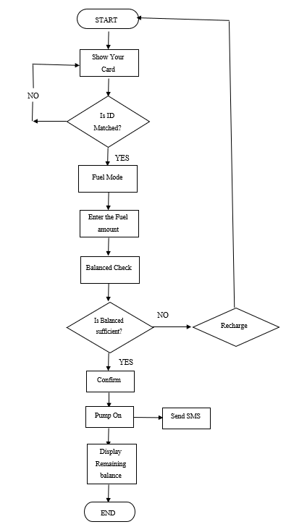
Fuel Dispensing System of Methodology
Fig 3: Flow chart of Fuel dispensing system

Slide 12
Hardware Requirements
ARDUINO UNO
RFID Reader
RFID Tags
GSM
LCD(16x2)
Relay Module
Pump Motor
Power Supply
Software Requirement
1. Arduino IDE

Slide 13
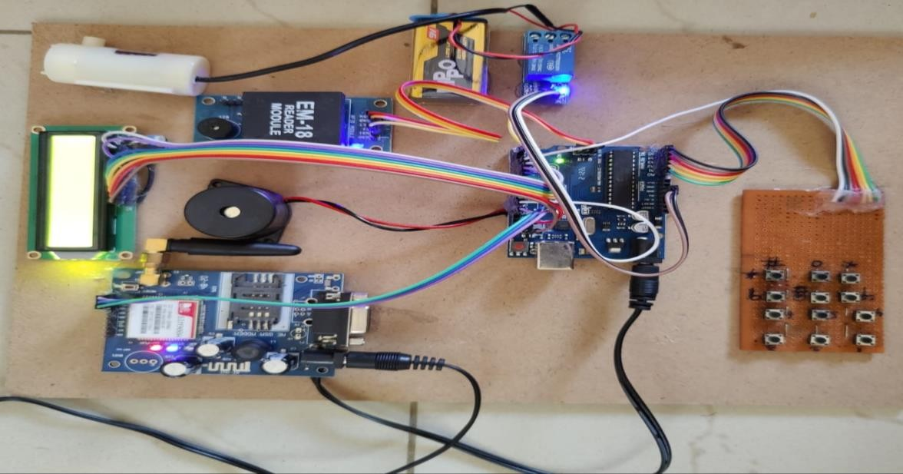

HARDWARE SETUP
LCD Display
Keypad
Fig 3 : Hardware Model of RFID Based Automated Petrol Pump System

Slide 14
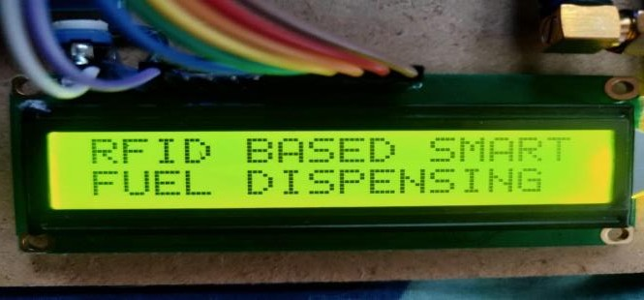
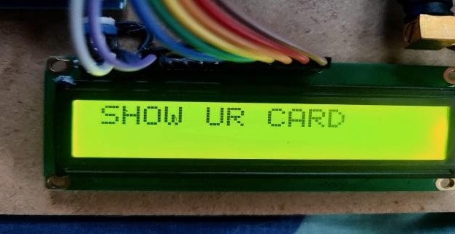
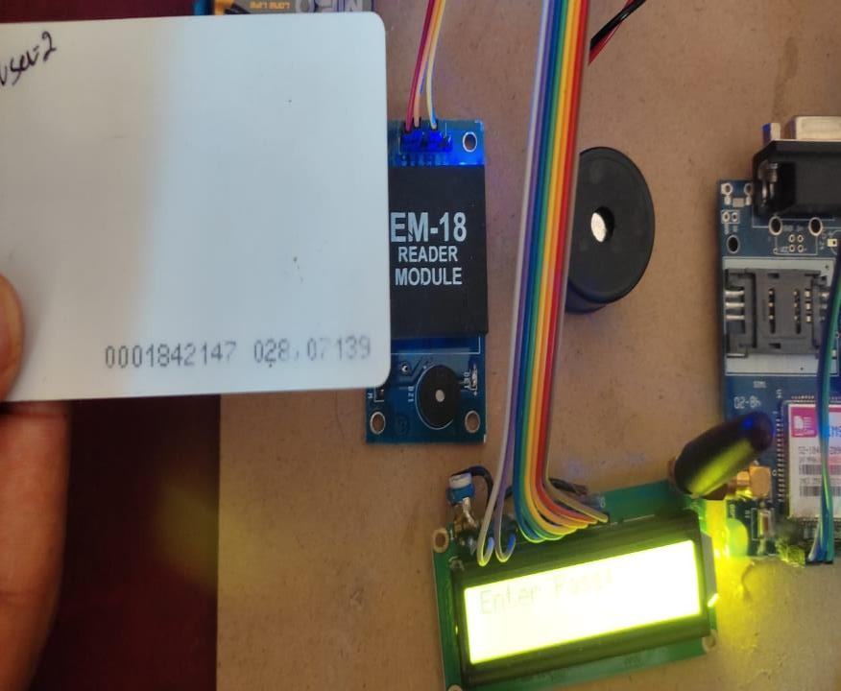
Performance Analysis
Firstly, authorized person should carry with their RFID card. Then LCD display represents that” Show Your Card” Which indicated in Figure 4.
Fig 4 : RFID Card using Entry

Slide 15
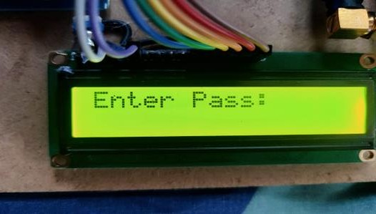
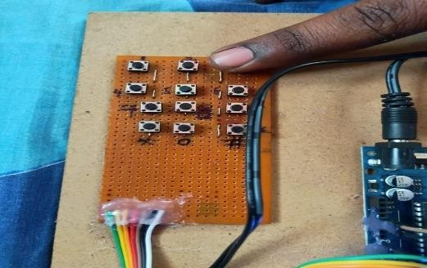
Password Protection:
In Figure 5 it shows that the user is required to enter the password to start the system..
Fig 5: User Password input via Keypad
15

Slide 16
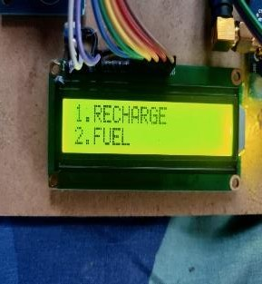
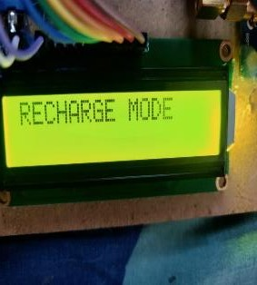
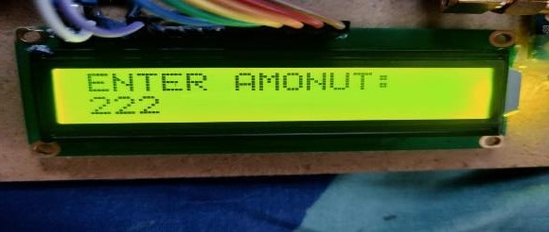
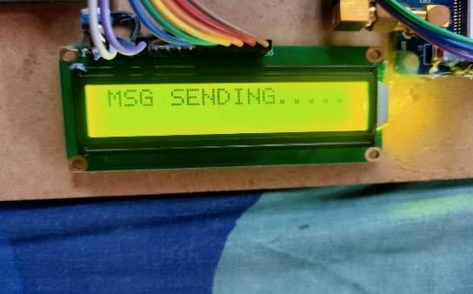
Recharge Mode:
Fig 6 shows the options after the correct password has been entered. It shows two options. If user selects option ‘1’ it asks the amount to be entered in order to recharge the card.
After recharging the amount, the system will again ask the user to show his card and enter the password, after which the LCD will display the remaining amount present in the user’s card.
Fig 6: Recharge Money Process

Slide 17
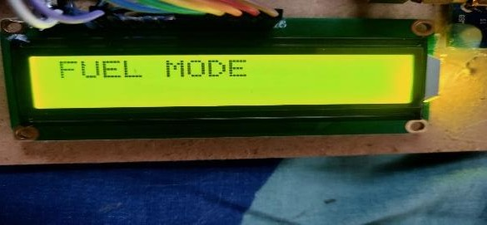
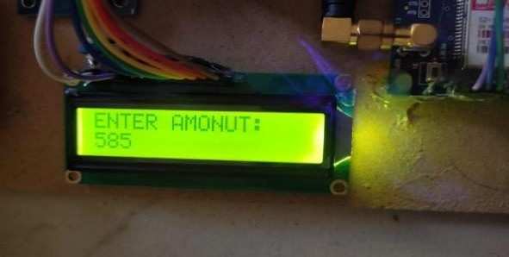
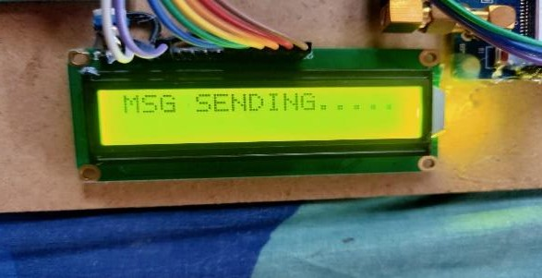
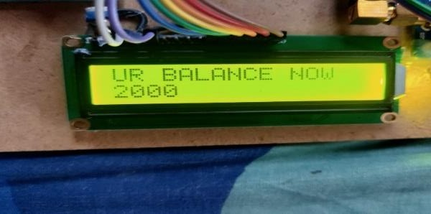
Fuel Mode:
Fig 7 shows, If the user has selected the Fuel Mode, then the system will ask the user to enter the amount for which the fuel needs to be dispensed.
The user will also receive a message regarding the amount he selected for the fuel dispensing. After the fuel has been dispensed the LCD will display the remaining amount in his card and the user will also receive a message on his phone regarding the same.
17
Fig 7: Processing Of Fuel Refill

Slide 18
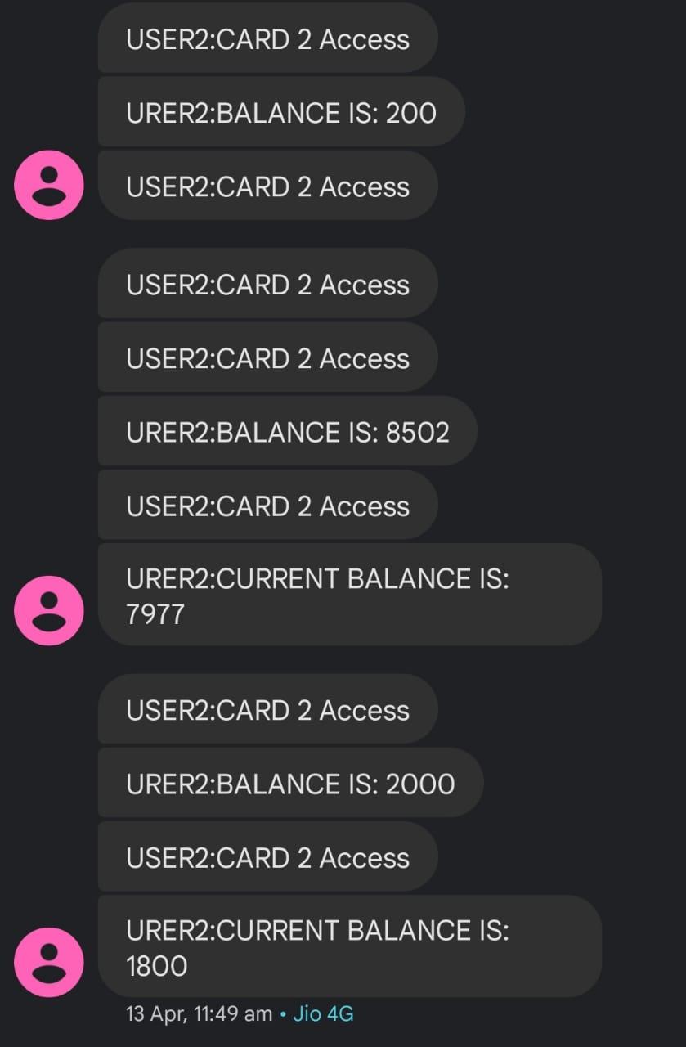
Messages
Fig8 : Message Alerts Received by GSM

Slide 19
ADAVANTAGES
Man power is reduced because of automated self service.
Due to use of RFID system robbery of the fuel is avoided.
The time is saved
Low Power Consumption.
It takes humans safer also no chance of fraud.
5/03/2022
19

Slide 20
CONCLUSION
The proposed smart fuel station controlling system by using RFID and GSM system. In this system, RFID dispenses the accurate amount of fuel which reduces the misuse of the fuel. Also reduces the manpower. Additionally, if the customer tries to swipe with the unauthorized card, the RFID system rejects the card. Therefore, the system is so secured.

Slide 21
FUTURE WORK
It has been observed that the proposed system is extremely beneficial as it provides the secure and cashless digital system, which avoids fuel thefts in recent digital India concept.
The proposed model of RFID Based Fuel station automation using Arduino Uno can be further enhanced by making it password protected. It can feature on biometric security in which only the person to whom the RFID card belongs, can only allowed to use it for access at fuel stations.
In this, each user will be having the unique pin or biometric for their respective RFID card. If the user enters the correct credentials, he will be asked to enter the amount and further process will take place.
On the other hand, if the entered credential is wrong, he will be given two more chances for the same, failing which access will be denied and security alarm will be raised alerting for the same. This will help to authenticate as well as secure the user. The unauthorized user is disallowed for any access to the system.

Slide 22
REFERENCES
Kulkarni Amruta M. &TawareSachin S(2019) Multipurpose Self Fuel Dispensing Automated Framework Utilizing RFID Prepaid Cards. (International Journal of Computer Technology & Electronic Engg.) Volume 2 (Issue 1), Page No.164-168.
Christo Ananth, G.Poncelina, M.Poolammal, S.Priyanka, M.Rakshana, Prakash.K(2018) “A System Design for the Regulated Distribution of Automotive Fuel Using RFID. ”, International Journal of Advanced Research in Biology, Ecology,Science and Technology(IJARBEST), Volume 1,Issue 4,July 2015, pp:26-28
Pranto, M. B., Rahman, M. M., & Zunayeed-Bin-Zahir(2020) Vehicle Fuel Monitoring and Management using RFID authentication and Telematics system (International Journal of Emerging Technology and Advanced Engineering) Volume 3, Issue 5, May 2013.
Al-Naima, Fawzi M and Hasan, Mohannad M (2015) Design and implementation of RFID-based fuel dispensing system International Journal of Computing and Network Technology

Slide 23
THANK YOU
Any Queries ?

